Slide 1
Improving credit scoring using bank stat CoRR(2016)
Kim YoungSang

Slide 2
Abstract
Goal :
Improvement of credit rating
Data :
Features derived from bank statements provided by loan applicants
+ Features specified in the application
How :
Configure baseline models based on existing scoring features only
+ Construct a second model based solely on the new bank statement derivative features
Best :
Naïve Bayse

Slide 3
Intro.
Y :
Possibility of default
Q :
except for online application form questions,
can a sufficiently predictable scoring model be created using only the bank statement derivative function?
Result :
ROC , combined model > application only model > bank statement only model

Slide 4
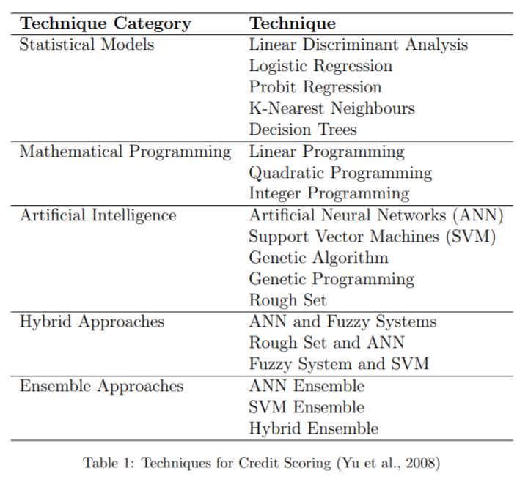



Credit Scoring
M : 고객 신청서 양식 & 신용 기관 정보
N: 대출 신청자 수 표본
Yk : 적시 상환 유부 관측 결과 (1, 0)

Slide 5
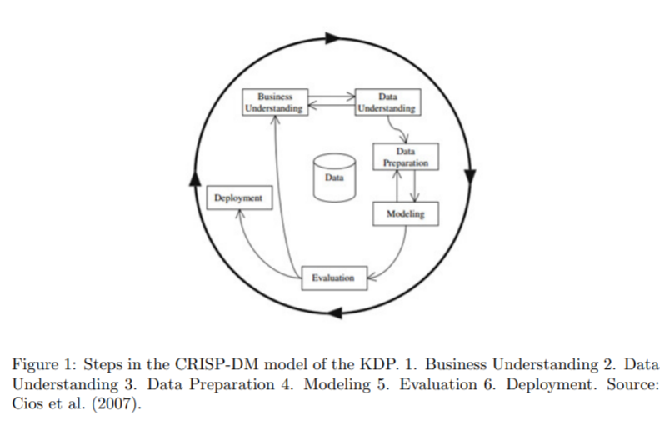
Method
CRISP - DM
Model
Logistic Regression
Naïve Bayes
Support Vector Machine(SVM) with linear kernel
Nearest Neighbor
J48 Decision Tree ( C4.5 )
Random Forest

Slide 6


Model Evaluation
In the credit scoring context, the costs of misclassification are quite different. False negatives only refer to the opportunity cost of lost interest that could have been gained, whereas for false positives, the lender loses some or all of not only the interest, but also the principal that was to be repaid
When the input data set is balanced, and there are equal costs associated with errors, accuracy is an appropriate measure to maximize when selecting a model. However, with imbalanced data and unequal error costs, the ROC curve or other similar techniques are more appropriate

Slide 7
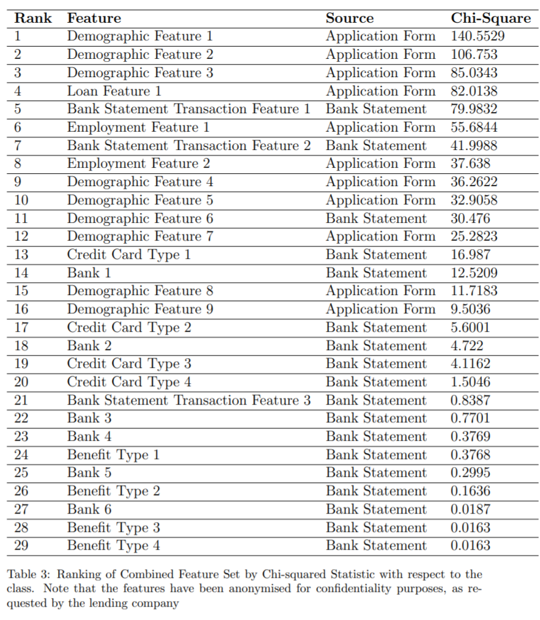
Feature
Extraction
Online application data
Bank statement data
Defining ‘Bad’
90 days
Selection
Filter (chi-square)
Wrapper
Discreting numeric feature
Binning algorithm

Slide 8
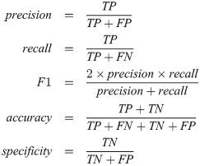

Class Imbalance
Data set : Normal instance 7401
Target Instance 121 (1.6%)
Solution :
cost-sensitive learning
Over sampling (SMOTE)
Set up
Cut off Optimizaion by F1 score

Slide 9
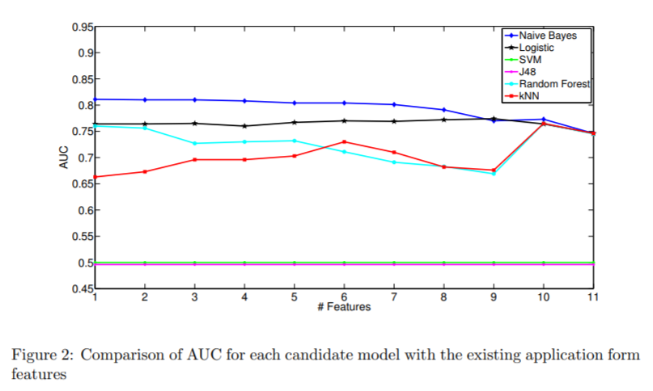
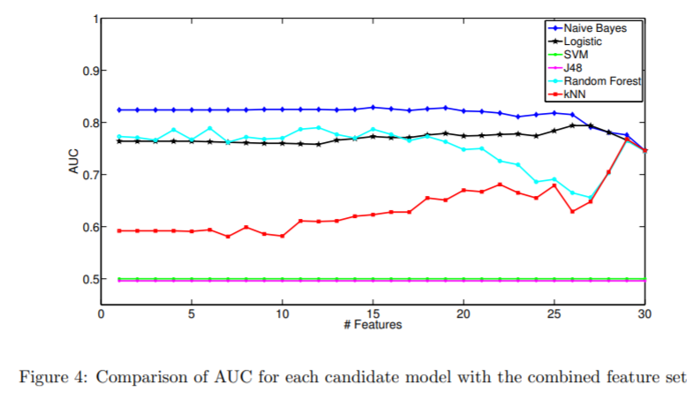
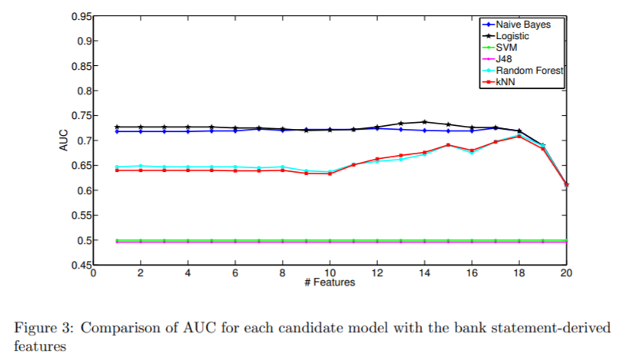
Model comparison
<

Slide 10
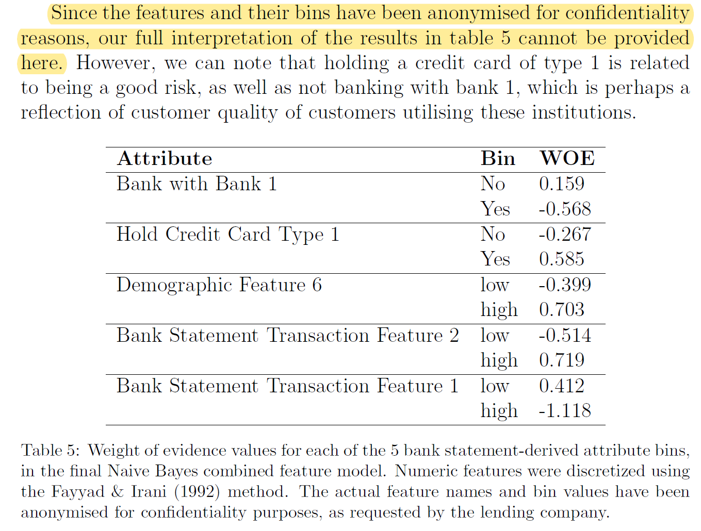
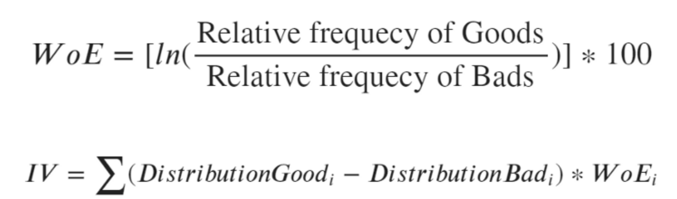
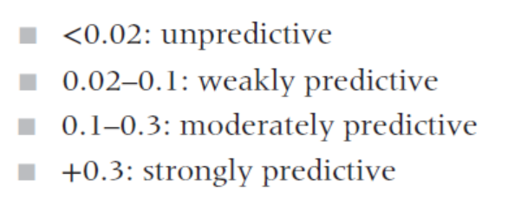
Bank Satement derived feature

Slide 11
Conclusion
This work has highlighted the potential of using bank statement information from applications such as Credit Sense, to obtain additional features to improve credit scoring.
Although the bank statement features were not sufficiently predictive by themselves, our experimental results showed that a number of the bank statement derived features have value in supplementing the application form features, in improving a credit scoring model.
we found that a Naive Bayes model that used 16 combined features provided the best performance in terms of area under the ROC curve (AUC).

